Slide 1
Acoustic Event Detection in real life audio
DCASE 2017 challenge using Convolutional Neural Networks

Slide 2
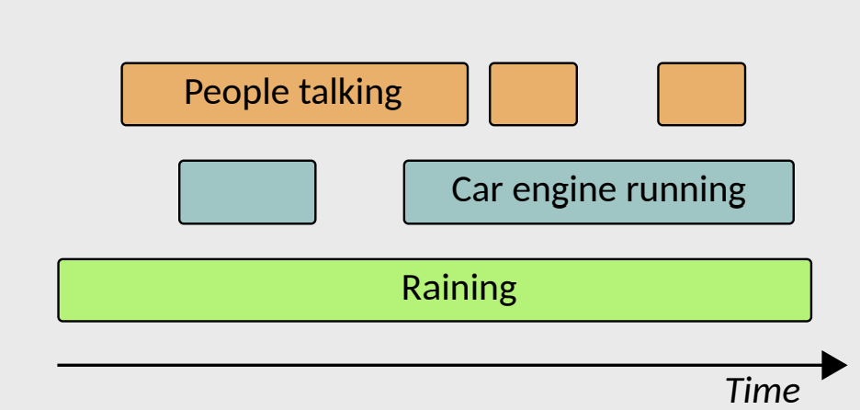
Introduction to the task
The goal is to recognize at what temporal instances different sounds are active within an audio signal.
We use non-speech and non-music sounds for this tasks which consists of environmental sounds such as brakes squeaking, car passing by, people walking, people speaking, large vehicles and children. Thus have 6 classes in total.

Slide 3
System setup
Input audio
Feature extraction
System training
Feature normalization
System testing

Slide 4
Dataset used
DCASE 2017 challenge dataset
Dataset uses materials recorded in real-life environments
Consists of 6 categories of labels with starting and ending time given for supervised learning.
1 hour and 32 minutes of audio in 24 recordings to train
29 minutes of audio in 8 recordings to evaluate

Slide 5
Features explored
Spectrogram
MFCC
Tempogram
Scalogram
Cochleagram
We used sampling rate as 44kHz and hop size 512. (add more)

Slide 6
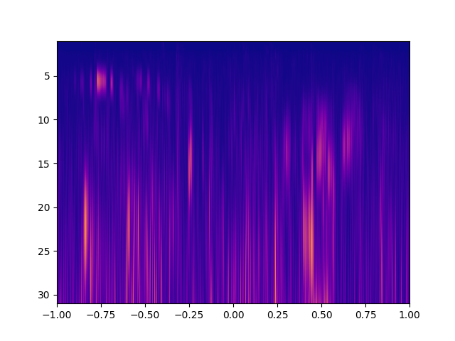
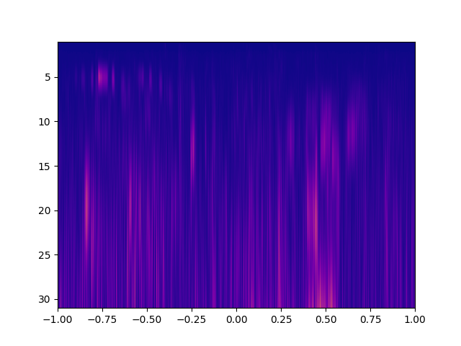
Scalogram
We have two types of wavelets : Continuous and discrete
Wavelet families vary from one to another because every family has a different trade-off in how compact and smooth the wavelet looks like.
We used various continuous wavelets to generate scalograms and compare them with each other.
Complex Gaussian, Gaussian, Morlet, Complex morlet, Mexican hat, Shannon

Slide 7
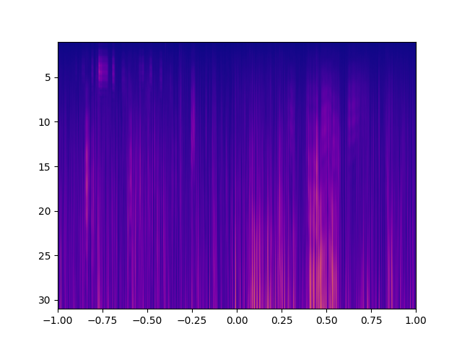
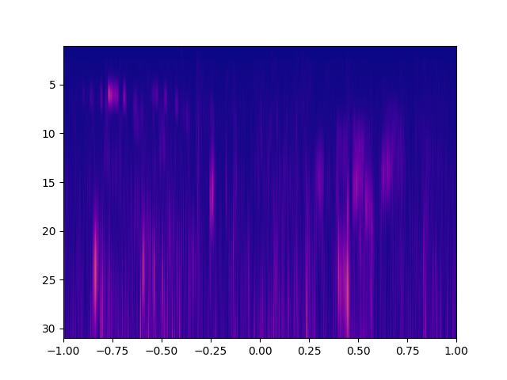
It is found that complex wavelets give a better result in identifying the time at which various frequencies are present.
And complex gaussian gives the best result in out case.
complex morlet morlet

Slide 8
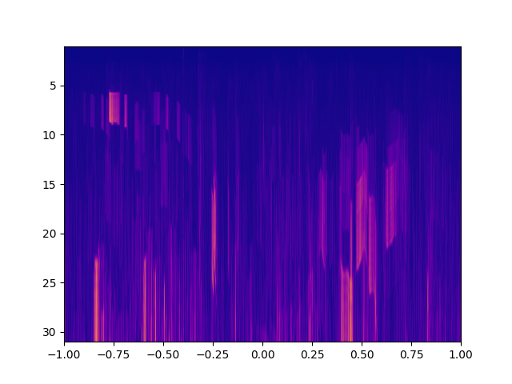
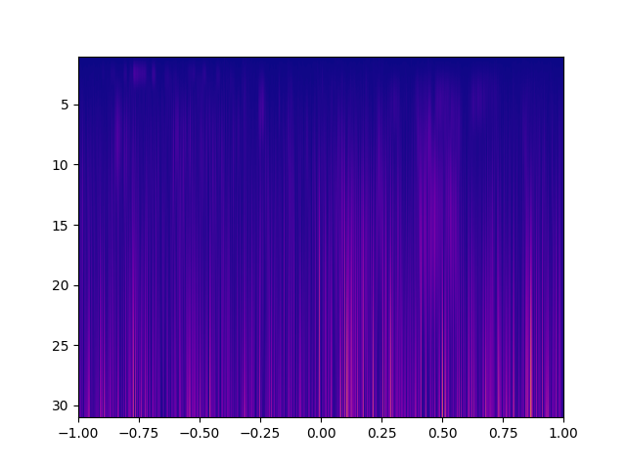
Shannon Wavelet Mexican hat

Slide 9
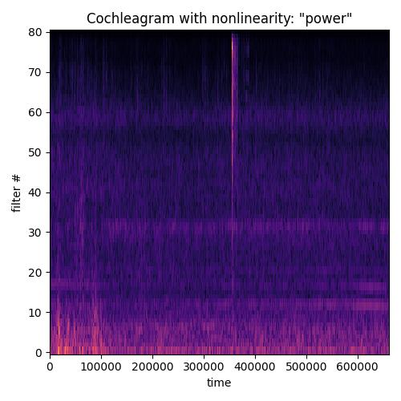
Cochleagram
A cochleagram is similar to a spectrogram but a cochleagram uses the human auditory model for determining the center frequencies and bandwidth.
It has more frequency components in the lower frequency range with smaller bandwidth and fewer frequency components in the higher frequency range with higher bandwidth.

Slide 10
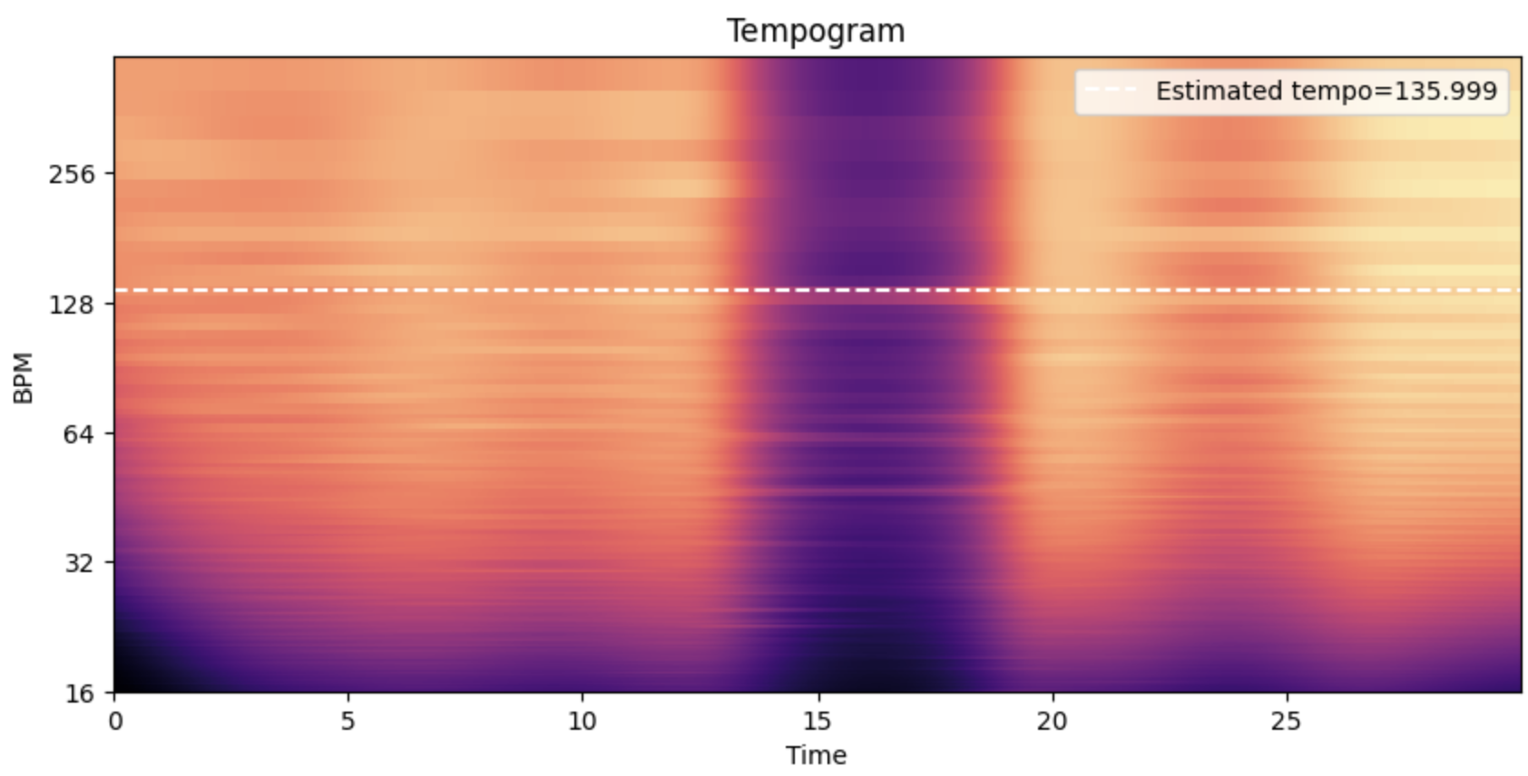
Tempogram
Tempogram is a mid-level representation of tempo information and is constructed to characterize tempo variation and local pulse in the audio signal.

Slide 11
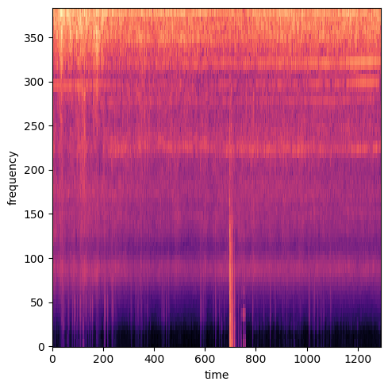
First we compute onset strength envelope using data given, and taking hop length as 512 and sampling rate 44kHz. Onset strength at time t is determined by: mean_f max(0, S[f, t] - ref[f, t - lag]) where if a time series y is provided, S will be the log-power Mel spectrogram. Onset means sudden rise of energy across the entire spectrum. We also tried concatenating and adding the Cochleagram and Tempogram but it doesn’t give the satisfactory result.

Slide 12
Convolutional Neural Network used
In our configuration of CNN, we use three sets of convolutional and pooling layers, with each set containing a convolutional layer of size (64, 5, 5) and a maximum pooling layer of size (2, 2).
Passing through each set of layers, the complexity of features declines gradually, and finally turns to an array of size (12, 4, 64).
We then flatten the array to one dimension with size 3,072, and pass it to the fully connected layers with two hidden layers using ReLU activation.
The whole network takes input features of size (64, 128, n) and transfers it to an array of size (6, n), where n is the number of patches of either the training or the test set
The post-processing step translates the 6*n array output into the required format containing the start and end time of each sound event.

Slide 13
Evaluation
In the baseline system evaluation parameters used are error rate.
Error: 2.7% baseline and 2.3% Ours.

